Slide 1

Using the What Works ClearinghouseTM (WWC) to Identify Strong or Moderate Evidence of Positive Effects from Education Interventions Jonathan Jacobson, Ph.D. jonathan.jacobson@ed.gov Senior Research Scientist National Center for Education Evaluation and Regional Assistance (NCEE) Institute of Education Sciences, U. S. Department of Education April 10, 2018
Notes:
This presentation is on using the What Works Clearinghouse to identify strong or moderate evidence of positive effects from education interventions. The WWC is an initiative of the Institute of Education Sciences, which is the research, statistics, and evaluation arm of the U. S. Department of Education.
My name is Jonathan Jacobson, and I work for the National Center for Education Evaluation and Regional Assistance within IES and serve on the WWC team.

Slide 2
Learning Goals
Understand the evidence tiers defined in federal education law and ED regulations
Learn how to find strong evidence and moderate evidence from WWC reviews of individual studies
Learn how to find strong evidence and moderate evidence (as well as promising evidence) from WWC systematic reviews (intervention reports and practice guides)
Learn how to connect with the WWC
Notes:
The goals for this presentation are to help you to:
--Understand what the term “evidence-based” means in the context of federal education law and U. S. Department of Education regulations
--Learn how to find *strong evidence* and *moderate evidence* from What Works Clearinghouse reviews of individual studies
--Learn how to find *strong evidence* and *moderate evidence* (as well as *promising evidence*) from WWC systematic reviews of evidence, which include both WWC intervention reports and WWC practice guides
--Learn how to connect with the WWC

Slide 3
Evidence Tiers in ED Law and Regulations
**Evidence in these tiers needs to demonstrate a statistically significant positive effect of a project component on a relevant outcome
[ED regulations require strong and moderate evidence to be from studies meeting WWC standards, version
2.1 or 3.0]
Strong Evidence** [WWC]
(based on at least 1 well-designed, well-implemented experimental study)
Promising Evidence**
(based on at least 1 well-designed, well-implemented correlational study with statistical controls for selection bias)
Evidence that Demonstrates a Rationale
Moderate Evidence** [WWC]
(based on at least 1 well-designed, well-implemented quasi-experimental design study)
Sources: 20 USC 7801 (21)
and EDGAR, 34 CFR 77.1
3
Notes:
Both federal education law and U.S. Department of Education general administrative regulations (known by the acronym EDGAR) define 4 tiers of evidence. These tiers are distinguished by the sorts of studies providing evidence in support of a project component (that is, an intervention or treatment investigated in a study).
--Strong evidence, the highest tier, needs to be based on at least 1 well-designed, well-implemented *experimental study* demonstrating a statistically significant and positive effect of a project component on a relevant outcome. ED regulations require this study to meet What Works Clearinghouse evidence standards without reservations, when assessed using Version 2.1 or Version 3.0 of the WWC Handbook.
--Moderate evidence needs to be based on at least 1 well-designed, well-implemented *quasi-experimental design study* demonstrating a statistically significant and positive effect of a project component on a relevant outcome. ED regulations require this study to meet What Works Clearinghouse evidence standards with or without reservations, when assessed using Version 2.1 or Version 3.0 of the WWC Handbook.
--Promising evidence needs to be based on at least 1 well-designed, well-implemented *correlational study with statistical controls for selection bias* demonstrating a statistically significant and positive effect of a project component on a relevant outcome. It is not necessary for this study to meet What Works Clearinghouse evidence standards or be reviewed by the WWC.
--The lowest tier, evidence that demonstrates a rationale, does not need to be based on research or evaluation with a statistically significant finding or that has been reviewed by the WWC, but should indicate that the project component is likely to improve a relevant outcome.
For the remainder of this presentation, we will focus on identifying *strong* or *moderate* evidence from individual studies reviewed by the WWC, and on identifying *strong*, *moderate*, or *promising* evidence from WWC intervention reports and practice guides. More information on ED evidence definitions (including the definitions of experimental and quasi-experimental design studies) and on the WWC process of reviewing individual studies is included in a separate presentation, “Understanding the Evidence Definitions Used for U. S. Department of Education Programs.”

Slide 4
Requirements of Individual Studies Providing Strong Evidence or Moderate Evidence
Characteristic | Strong Evidence | Moderate Evidence
WWC study rating (under version 2.1 or 3.0 of the WWC Handbook) | Meets standards without reservations | Meets standards with reservations or Meets standards without reservations
Study findings for relevant outcomes | Statistically significant and positive (favorable) for at least one relevant outcome, with no overriding statistically significant and negative effects on relevant outcomes reported in the study or in a corresponding WWC intervention report (under version 2.1 or 3.0 of the WWC Handbook)
Study sample (alone or in a combination of studies) | Large sample (350+ individuals) and multi-site sample (e.g., >1 State, county, city, district, or campus)
Overlap with proposed populations / settings | Overlap with both required | Overlap with either required
Source: EDGAR, 34 CFR 77.1
4
Notes:
To provide strong or moderate evidence as defined by the Department, an individual study must meet certain requirements.
First, the study must have been reviewed by the Department using version 2.1 or version 3.0 of the WWC Procedures and Standards Handbook. To provide strong evidence, the study must receive the highest WWC study rating: Meets WWC standards *without* reservations. To provide moderate evidence, the study must either meet WWC standards with reservations, or meet WWC standards without reservations.
Second, the study needs to demonstrate a statistically significant and positive (that is, favorable) effect of the intervention on at least one relevant outcome, with no *overriding* statistically significant and *negative* effects on relevant outcomes reported in the study or in a corresponding WWC intervention reported prepared under version 2.1 or version 3.0 of the WWC Handbook.
Third, the study sample—either alone or in combination with other studies of the same intervention and meeting the same requirements—must be both a large sample and a multi-site sample. A large sample is defined as including 350 or more individuals. A multi-site sample is defined as including more than one State, county, city, school district, or postsecondary campus.
Finally, to provide strong evidence, the study must include a sample that overlaps with *both* the populations *and* the settings proposed for the project. To provide moderate evidence, the study must overlap with *either* the populations *or* the settings proposed for the project. For example, for a project serving low-income students in rural elementary schools, an individual study could provide moderate evidence but not strong evidence if it was based on a sample of low-income students in urban elementary schools and met the other requirements for moderate evidence described in this table.
Note that, to provide *promising evidence*, a study doesn’t need to have been reviewed by the WWC or meet WWC standards, as long as it demonstrates a statistically significant and positive effect of the intervention on a relevant outcome and includes statistical controls for selection bias. More information on the sorts of studies that can provide promising evidence is included in the separate presentation, “Understanding the Evidence Definitions Used for U. S. Department of Education Programs.”

Slide 5
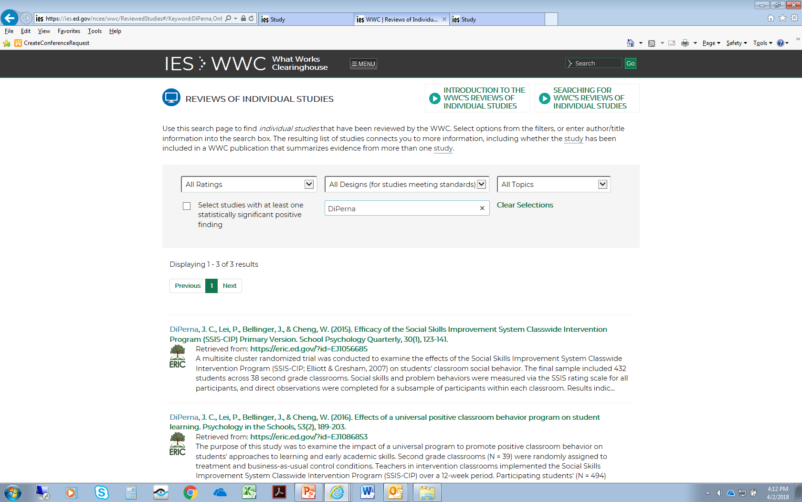


Search in the Reviews of Individual Studies Database
5
Notes:
To see if a study has been reviewed by the What Works Clearinghouse and could provide strong or moderate evidence, go to the reviews of individual studies database on the WWC website.
You can search for studies by entering information such as an author name, year of publication, and title. You can also filter studies by their WWC rating, study design, topic area, and whether the WWC confirmed any statistically significant and positive findings from the study.
In this example, we search for a 2015 study by DiPerna and collaborators on the Social Skills Improvement System Classwide Intervention Program (or SSIS-CIP). We search for studies with DiPerna as an author but don’t impose any other restrictions, since we have a specific lead author in mind but might not know the study’s design, WWC rating, or topic area category. We obtain 3 results when searching for DiPerna, the first of which is the 2015 study we are seeking.

Slide 6
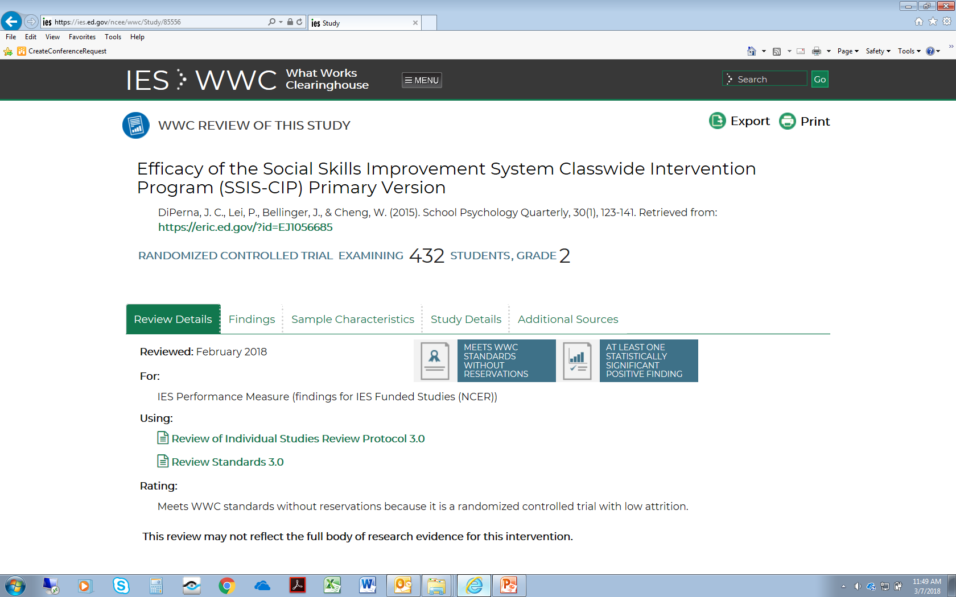
Check for the Handbook Version, Study Rating, and at least one Statistically Significant and Positive Finding
6
Notes:
The study page for the 2015 DiPerna study of the SSIS-CIP shows that the study was reviewed under version 3.0 of the WWC Procedures and Standards Handbook and was rated, “Meets WWC Standards without Reservations.” This review was posted to the WWC website in February 2018.
The study page also shows that the WWC confirmed at least one statistically significant and positive finding from the study. More detailed information on study findings confirmed by the WWC can be found by clicking on the “Findings” tab.

Slide 7
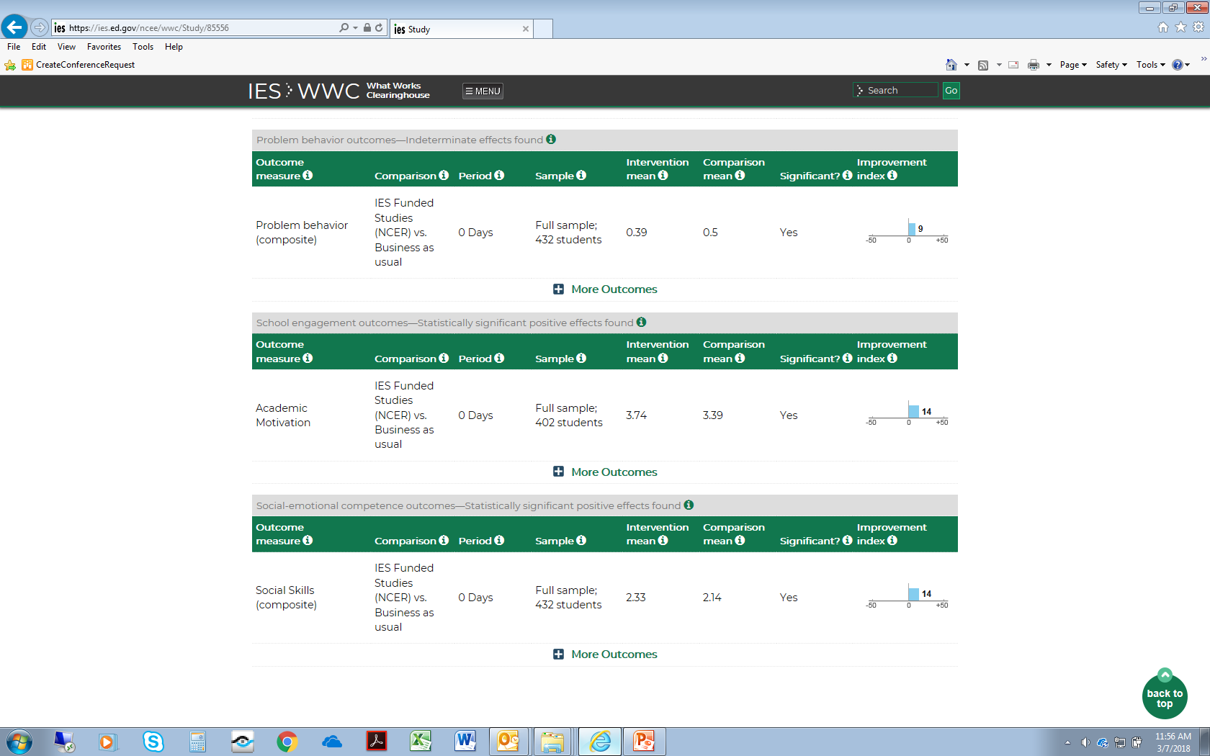
Look for Statistically Significant, Favorable Findings
7
Notes:
The study findings confirmed by the WWC include multiple statistically significant and positive findings: a positive impact on academic motivation (an outcome in the school engagement domain) and a positive impact on social skills (an outcome in the social-emotional competence domain). Note that these findings were based on samples of 402 and 432 students, both of which exceed the minimum sample of 350 required for a “large sample” under the Department’s definitions of strong and moderate evidence.

Slide 8
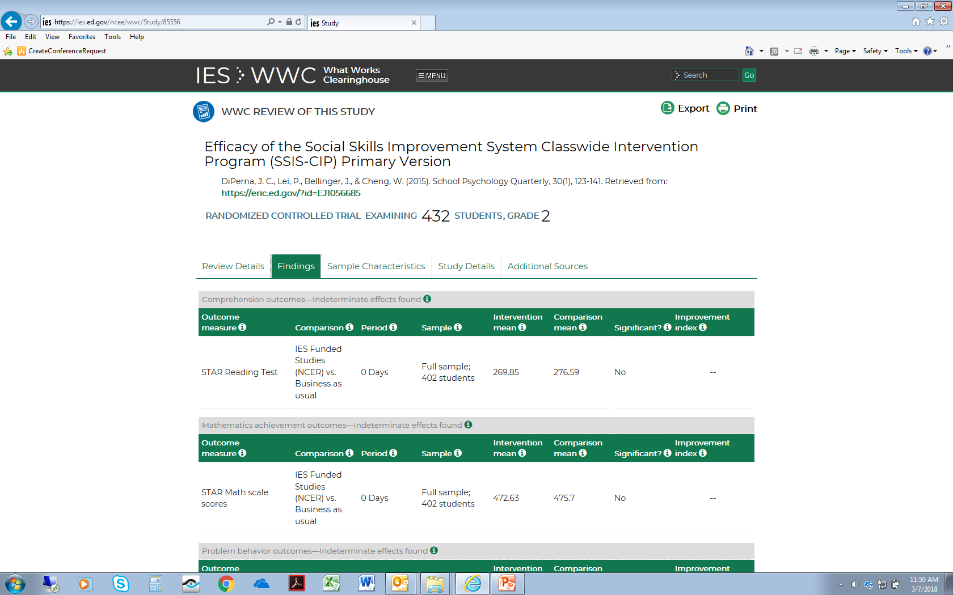
Check for No Overriding Findings in the Study Itself…
8
Notes:
While indeterminate effects were found on outcomes in other domains, including reading comprehension, mathematics achievement, and problem behavior, there were no statistically significant and negative effects confirmed by the WWC in the study itself that would override the positive findings.

Slide 9
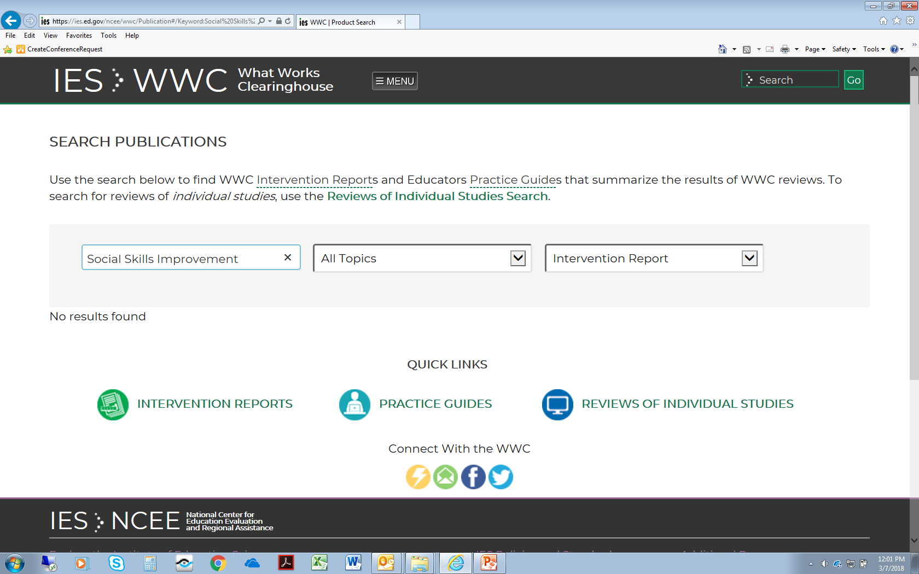
…or in a Corresponding WWC Intervention Report
9
Notes:
In addition, there is no WWC intervention report on Social Skills Improvement that includes any additional findings to consider as possibly overriding evidence of the intervention’s effectiveness.
That there was no intervention report on Social Skills Improvement is shown by the fact that the result of this search was “No results found.”

Slide 10
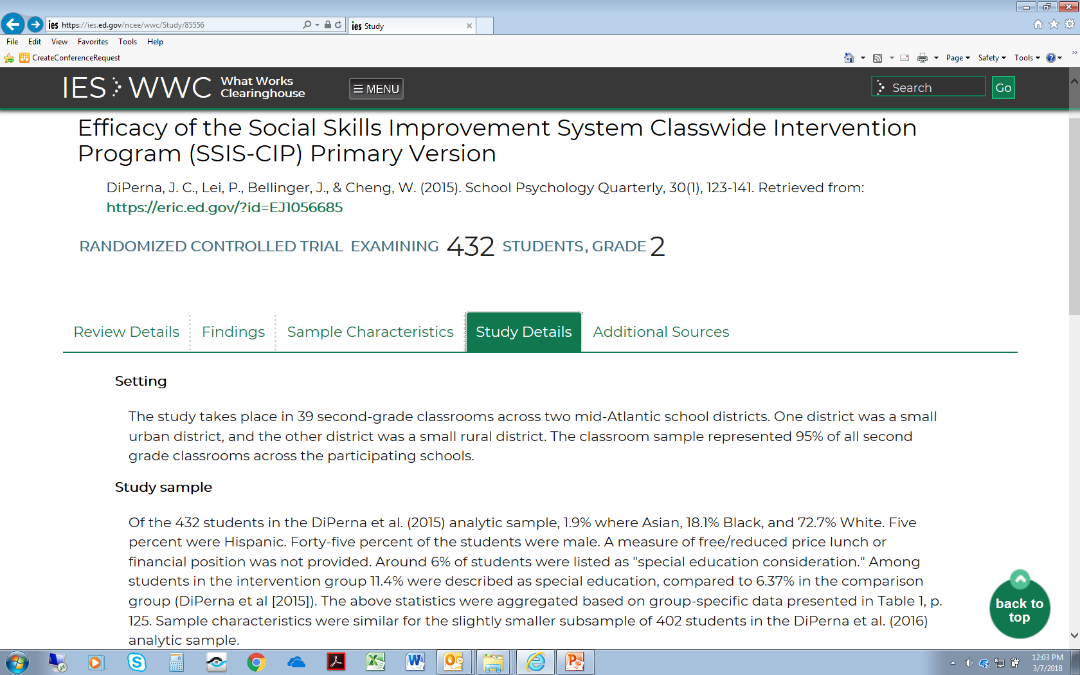
Look for a Large Sample and a Multi-Site Sample
10
Notes:
As previously noted, the positive findings from this study are based on samples that satisfy the Department’s large-sample requirement for strong and moderate evidence. By selecting the “Study Details” tab on the study page, we can see that the study took place in 39 second-grade classrooms across two mid-Atlantic school districts. Because the study occurred in more than one district, it satisfies the “multi-site sample” requirement needed for strong and moderate evidence.

Slide 11
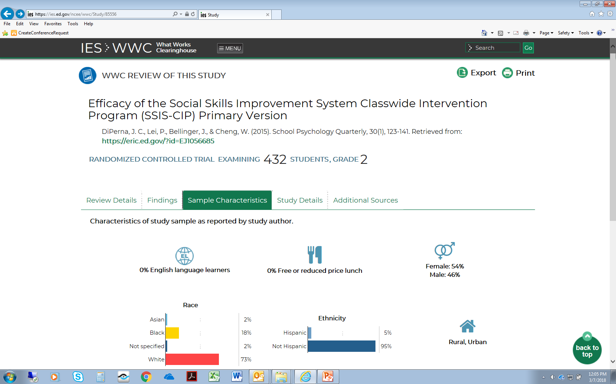
Check for Overlap of Populations and/or Settings
11
Notes:
The “Sample Characteristics” tab describes the grade level and demographic characteristics of the students included in the study sample, as well as the settings in which the study occurred. This information could help us assess the overlap of the populations and settings in the study with the populations and settings proposed for a project.

Slide 12
Requirements of a WWC Intervention Report Providing Strong Evidence or Moderate Evidence
Characteristic | Strong Evidence | Moderate Evidence
Intervention report findings (under version 2.1 or 3.0 of the WWC Handbook) for relevant outcomes | “Positive effect”, with no reporting of a “negative effect” or “potentially negative effect” | “Positive effect” or “potentially positive effect”, with no reporting of a “negative effect” or “potentially negative effect”
Extent of evidence | Medium to large
Overlap with proposed populations / settings | Overlap with both required |  | Overlap with either required
Source: 34 EDGAR CFR 77.1
12
Notes:
Now let’s consider how a What Works Clearinghouse intervention report can provide strong or moderate evidence. The advantage of an intervention report over a review of an individual study is that the intervention report is based on a systematic review of ALL studies of that intervention that meet WWC standards with or without reservations.
To provide strong or moderate evidence as defined by the Department, a WWC intervention report must meet certain requirements.
First, the intervention report must have been prepared by the WWC using version 2.1 or version 3.0 of the WWC Procedures and Standards Handbook. To provide strong evidence, the intervention report must report a “positive effect” of the intervention on a relevant outcome, with no reporting of a “negative effect” or a “potentially negative effect” on a relevant outcome. To provide moderate evidence, the report must report either a “positive effect” or a “potentially positive effect” of the intervention on a relevant outcome, with no reporting of a “negative effect” or a “potentially negative effect” on a relevant outcome.
Second, the extent of evidence for the effects of the intervention on the relevant outcome needs to be characterized as “medium to large” in the intervention report.
Finally, to provide strong evidence, the studies contributing to the intervention report must include a sample that overlaps with *both* the populations *and* the settings proposed for the project. To provide moderate evidence, the studies contributing to the intervention report must overlap with *either* the populations *or* the settings proposed for the project. For example, for a project serving low-income students in urban high schools, an intervention report could provide strong evidence if it included a study sampling low-income students in urban high schools and met the other requirements for strong evidence described in this table.

Slide 13
Requirements of a WWC Intervention Report Providing Promising Evidence
Characteristic | Promising Evidence
Intervention report findings (under any version of the WWC Handbook) for relevant outcomes | “Positive effect” or “potentially positive effect”, with no reporting of a “negative effect” or “potentially negative effect”
Extent of evidence | Either “small” or “medium to large”
Overlap with proposed populations / settings | Overlap with neither required
Source: EDGAR, 34 CFR 77.1
13
Notes:
To provide promising evidence as defined by the Department, a WWC intervention report must meet a more limited set of requirements.
To provide promising evidence, the intervention report must report either a “positive effect” or a “potentially positive effect” of the intervention on a relevant outcome, with no reporting of a “negative effect” or a “potentially negative effect” on a relevant outcome. The version of the WWC Handbook used to prepare the intervention report does not matter in the case of promising evidence.
To qualify as promising evidence, the intervention report may characterize the extent of evidence for the effects of the intervention on the relevant outcome as *either* “small” or “medium to large”.
Finally, in the case of promising evidence, the studies contributing to the intervention report do *not* need to overlap with *either* the populations *or* the settings proposed for the project.

Slide 14
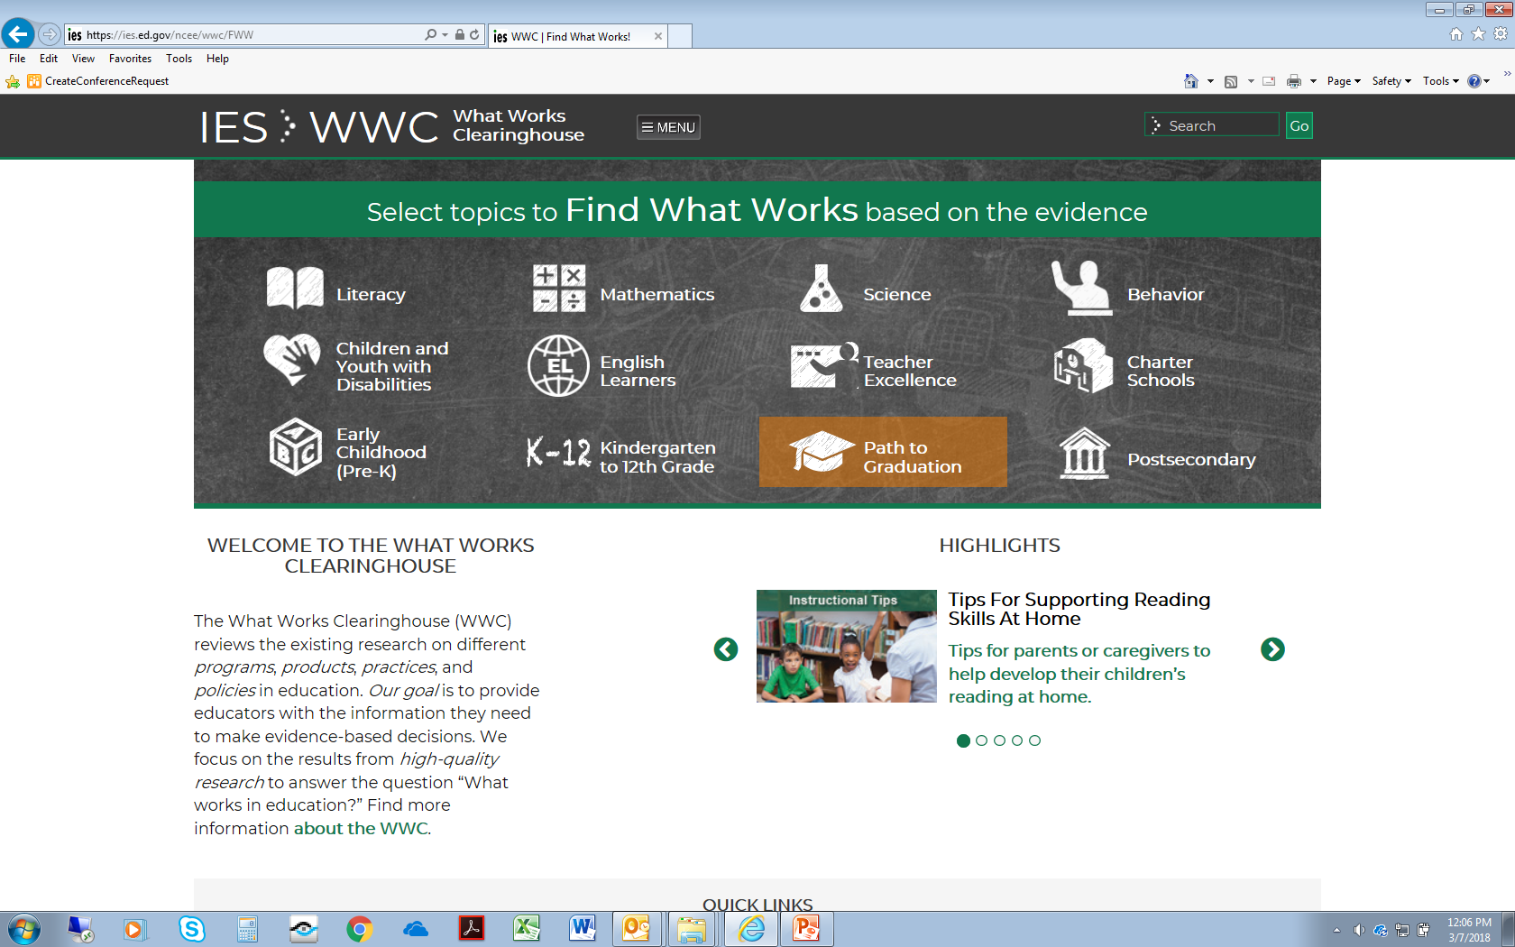
Find What Works Displays Results from Intervention Reports
14
Notes:
A convenient way to search for intervention reports is to use the Find What Works tool on the WWC website. In this example, we search for interventions in the topic area of “Path to Graduation.”

Slide 15
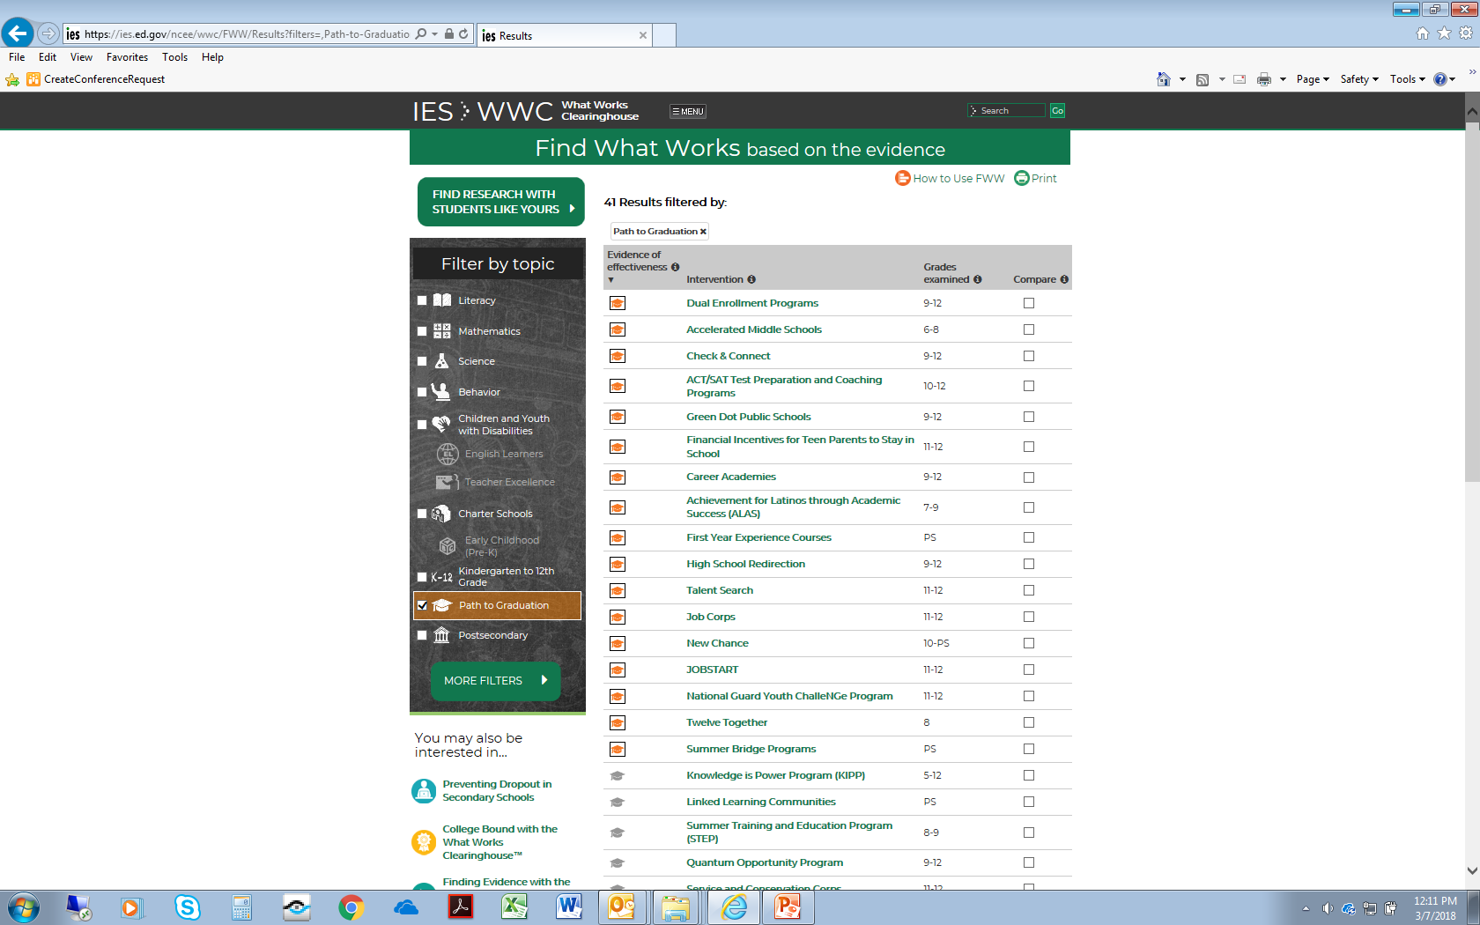
Interventions with Positive or Potentially Positive Effects
15
Notes:
Among the interventions in the “Path to Graduation” topic area, several are characterized as having positive effects or potentially positive effects on outcomes. The first of these intervention reports is for Dual Enrollment Programs.

Slide 16
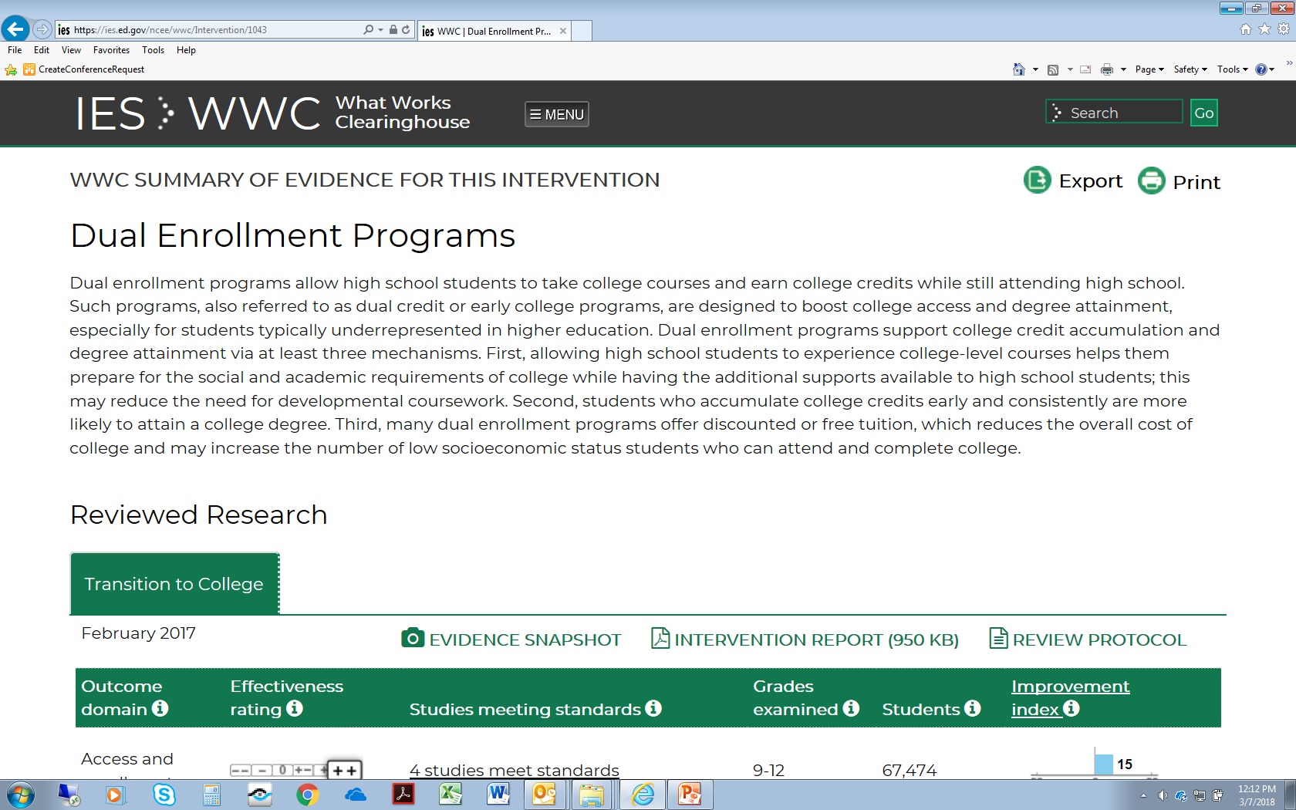
From the Intervention Page, Look for the PDF of the Report
16
Notes:
The intervention report for Dual Enrollment Programs was released by the WWC in February 2017. In addition to the information reported on the intervention page, there is more detailed information included in the PDF of the intervention report.

Slide 17
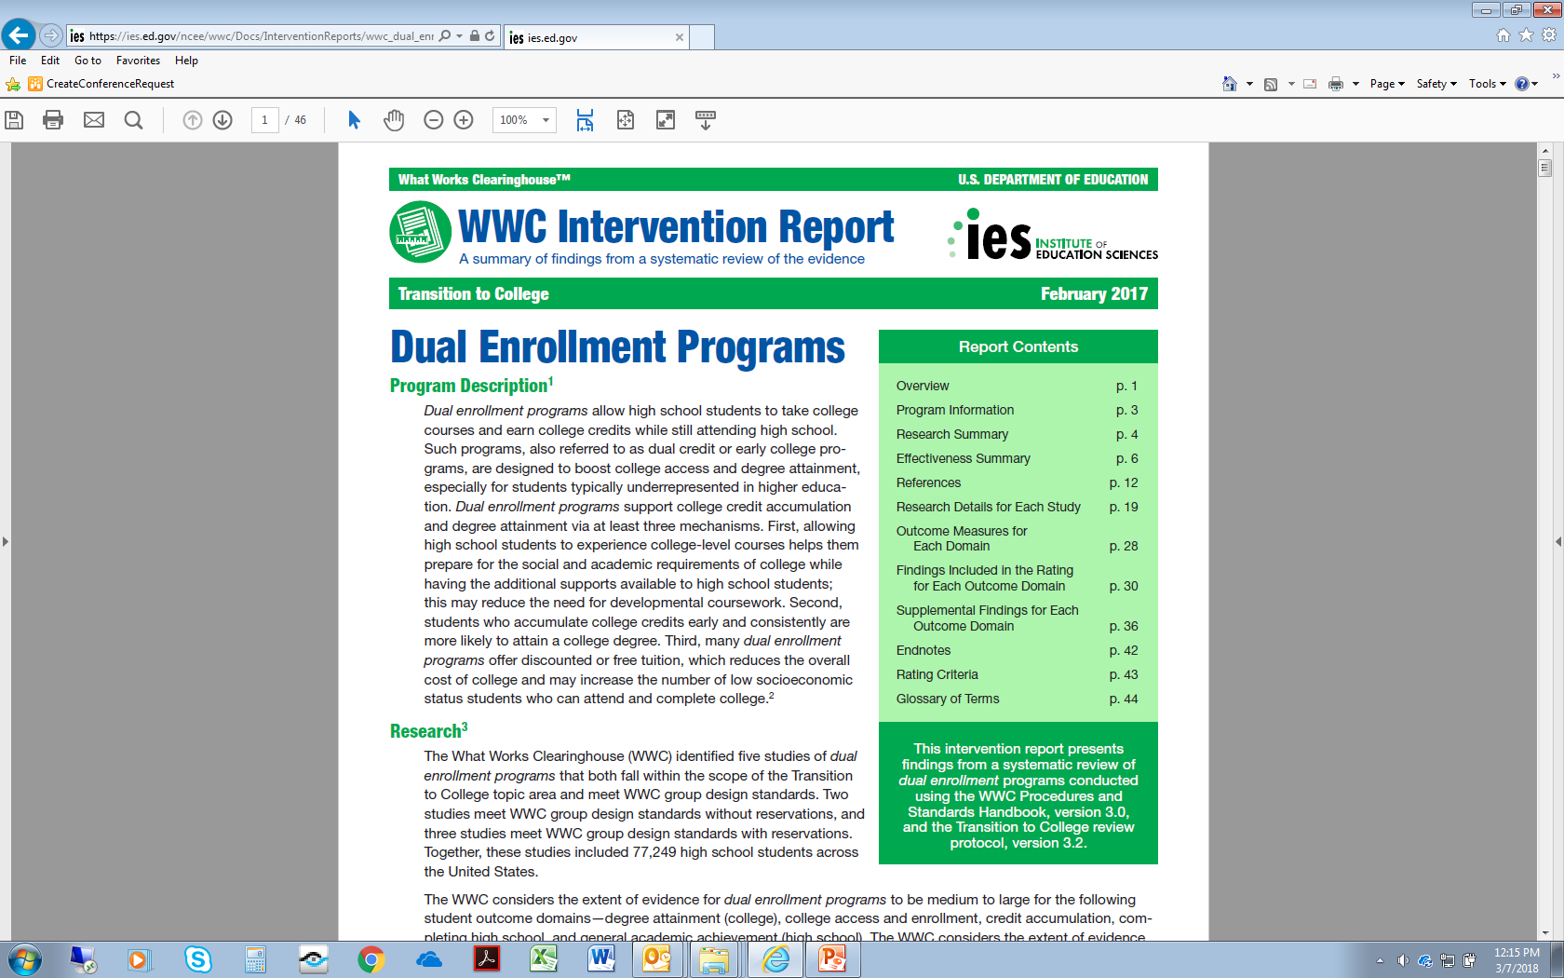
Confirm the Handbook Version Used for the Report
17
Notes:
The first page of the intervention report states that the report was prepared under version 3.0 of the WWC Procedures and Standards Handbook and also indicates the specific study review protocol used for the corresponding systematic review.

Slide 18
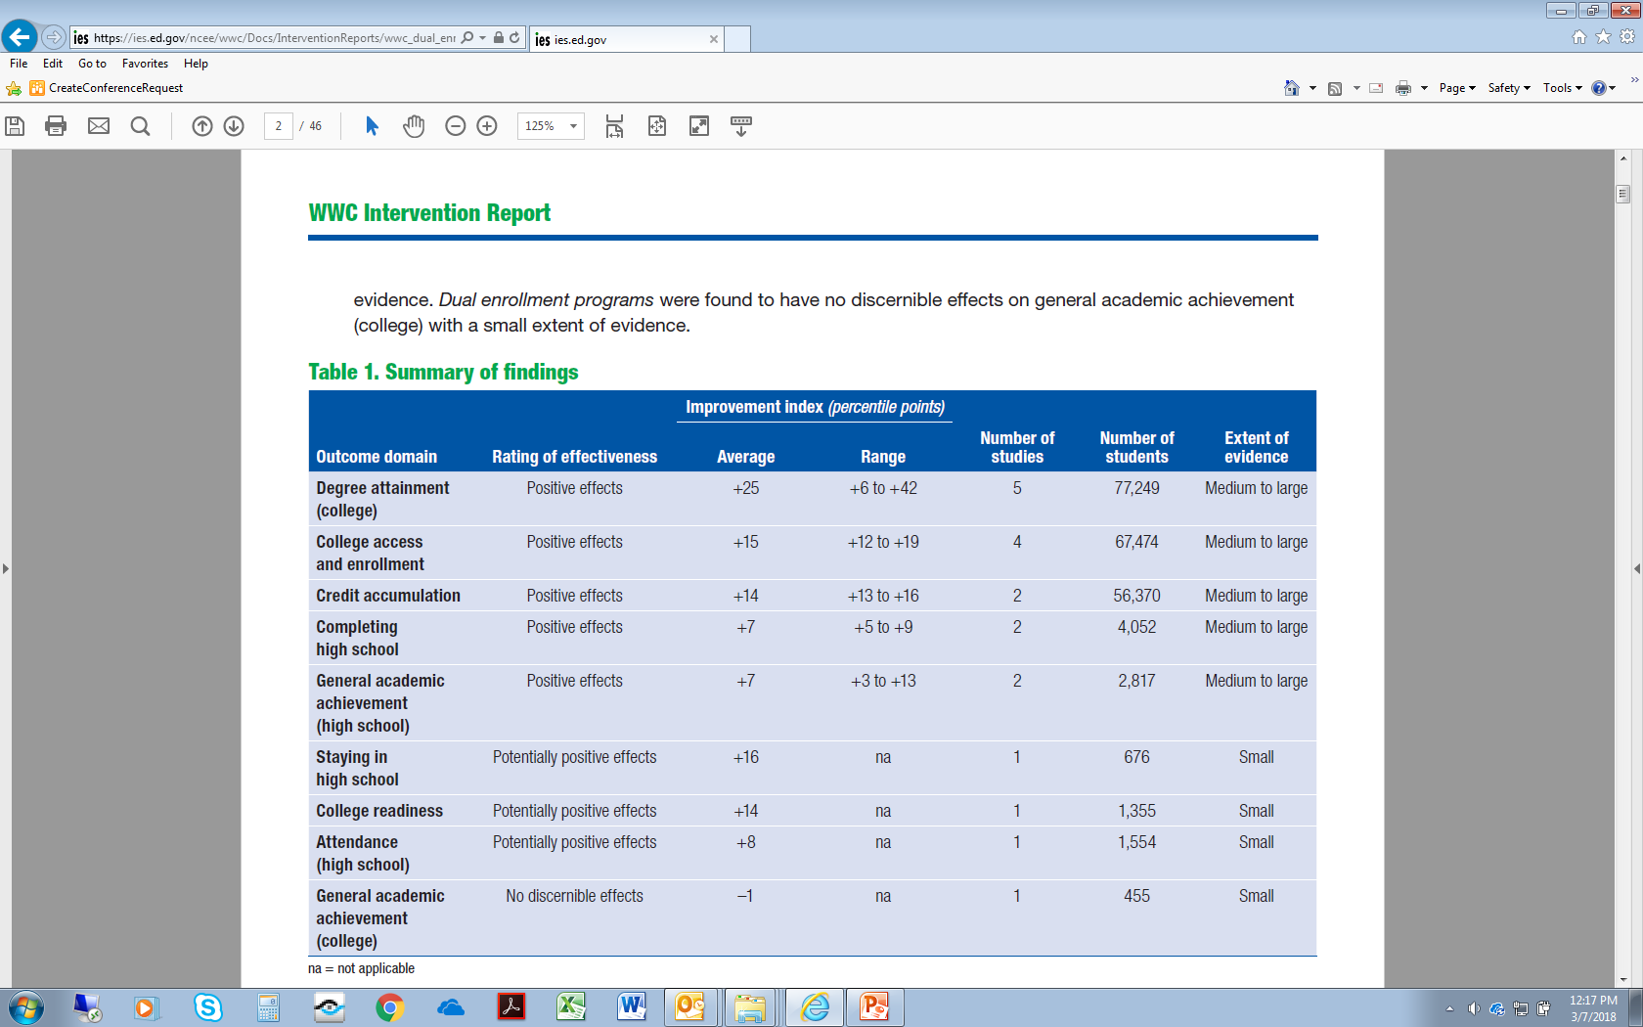
Look at the Effectiveness Rating and the Extent of Evidence
18
Notes:
Table 1 of the intervention report lists a summary of findings on the effectiveness of the intervention. In the case of Dual Enrollment, “positive effects” are reported in five outcome domains. These outcome domains are
--degree attainment in college
--college access and enrollment
--credit accumulation
--completing high school
(and)
--general academic achievement in high school
For each of these five outcome domains, the WWC characterizes the extent of evidence as “medium to large.”

Slide 19
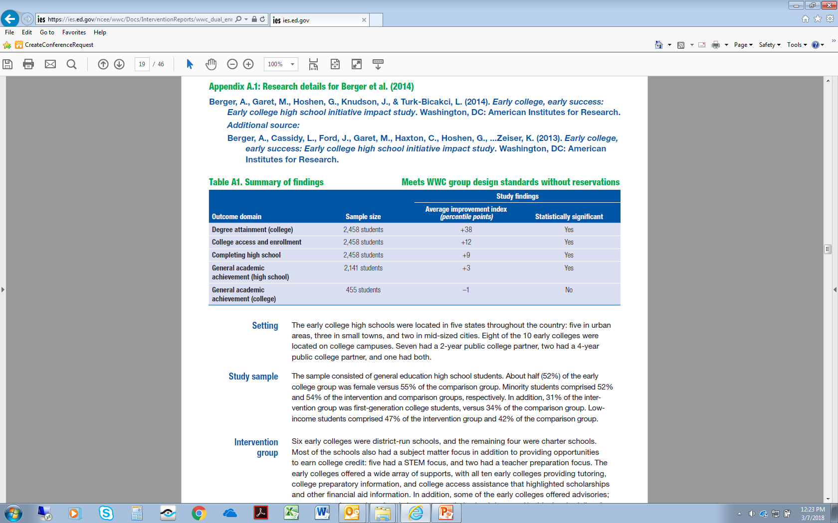
Check Overlap of Populations and/or Settings
19
Notes:
In order to provide strong evidence in support of a proposed project component, the studies contributing to the intervention report would need to overlap with *both* the populations *and* the settings proposed for a project. Appendix A of the intervention report provides information on the settings and samples included in each study meeting WWC standards. This information could help us assess the overlap of the populations and settings in the study with the populations and settings proposed for a project.

Slide 20
Requirements of a WWC Practice Guide Providing Strong Evidence or Moderate Evidence
Characteristic | Strong Evidence | Moderate Evidence
Evidence (under version 2.1 or 3.0 of the WWC Handbook) for practice recommendation cited for a proposed project component | “Strong evidence” base | “Strong evidence” base or “moderate evidence” base
Overlap with proposed populations / settings | Overlap with both required | Overlap with either required
Source: EDGAR, 34 CFR 77.1
20
Notes:
Another type of systematic review conducted by the What Works Clearinghouse is a practice guide. In contrast with intervention reports, which assess evidence for certain “branded” interventions, practice guides characterize the evidence supporting a set of recommendations made by a panel of researchers and practitioners focused on instruction in a particular topic area.
To serve as sources of strong or moderate evidence under the Department’s definitions, a WWC practice guide must have been prepared under version 2.1 or version 3.0 of the WWC Handbook. Note that, when citing a practice guide, an applicant to an ED grant program should cite a specific practice recommendation in the guide that is both relevant to the proposed project, and that meets the evidence requirements defined in the Notice Inviting Applications.
To provide strong evidence, the practice guide recommendation must be characterized as supported by a “strong evidence” base. To provide moderate evidence, the practice guide recommendation must be characterized as supported by either a “strong evidence” base or a “moderate evidence” base.
To provide strong evidence, the studies contributing to the practice guide recommendation cited for a project must include a sample that overlaps with *both* the populations *and* the settings proposed for the project. To provide moderate evidence, the studies contributing to the practice guide recommendation cited for a project must overlap with *either* the populations *or* the settings proposed for the project. The populations and settings of the samples included in the studies supporting each practice recommendation are described in Appendix D of the corresponding practice guide.

Slide 21
Requirements of a WWC Practice Guide
Providing Promising Evidence
Characteristic | Promising Evidence
Evidence (under any version of the WWC Handbook) for practice recommendation cited for a proposed project component | “Strong evidence” base or “moderate evidence” base
Overlap with proposed populations / settings | Overlap with neither required
Source: EDGAR, 34 CFR 77.1
21
Notes:
To provide promising evidence as defined by the Department, a WWC practice guide recommendation must be characterized as supported by either a “strong evidence” base or a “moderate evidence” base. The version of the WWC Handbook used to prepare the practice guide does not matter in the case of promising evidence.
In addition, in the case of promising evidence, the study samples contributing to the practice recommendation do not need to overlap with *either* the populations *or* the settings proposed for the project.

Slide 22
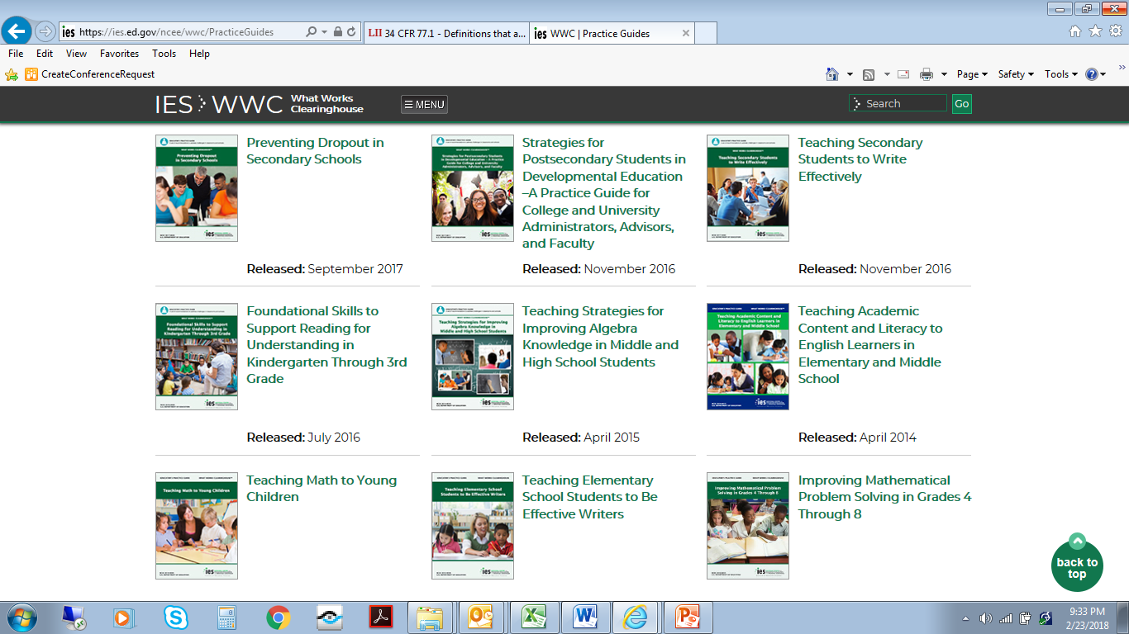
Practice Guides Prepared Under Version 2.1 or 3.0
Released: November 2013
22
Notes:
Between September 2007 and September 2017, the What Works Clearinghouse released 22 practice guides. Of these, 7 practice guides were prepared under version 2.1 or version 3.0 of the WWC Procedures and Standards Handbook. These seven guides cover the following topics:
--Preventing Dropout in Secondary Schools
--Strategies for Postsecondary Students in Developmental Education
--Teaching Secondary Students to Write Effectively
--Foundational Skills to Support Reading for Understanding in Kindergarten through 3rd Grade
--Teaching Strategies for Improving Algebra Knowledge in Middle and High School Students
--Teaching Academic Content and Literacy to English Learners in Elementary and Middle School
(and)
--Teaching Math to Young Children
As the WWC releases new or updated practice guides, these will be posted for free download on the WWC website.

Slide 23
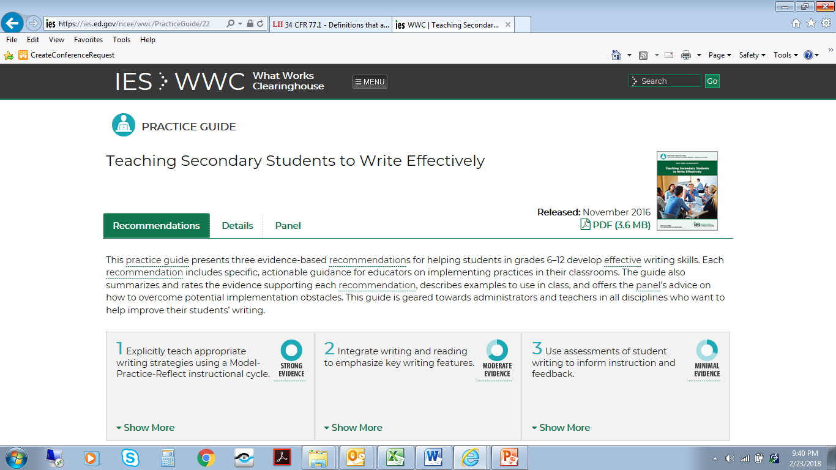
NOTE: “Minimal Evidence” Recommendations Do NOT Qualify as Strong, Moderate, or Promising Evidence
23
Notes:
Note: practice guide recommendations characterized as based on a “minimal evidence” base reflect the expert opinion of the panel of researchers and practitioners contributing to the guide. These recommendations may be useful to projects but do NOT qualify as either strong, moderate, or promising evidence under the Department’s evidence definitions.

Slide 24




Ways to Connect with the WWC
The WWC Home Page
whatworks.ed.gov → https://ies.ed.gov/ncee/wwc/
The WWC Help Desk
http://ies.ed.gov/ncee/wwc/ContactUs.aspx
Follow the WWC
http://facebook.com/whatworksclearinghouse
https://twitter.com/WhatWorksED
http://ies.ed.gov/newsflash/?url=%2Fncee%2Fwwc%2Findex%2Easp&site=What+Works+Clearinghouse
Notes:
Before concluding this presentation, I want to make sure you are aware of several different ways to connect with the What Works Clearinghouse.
First, you can visit the WWC website, whatworks.ed.gov.
Second, you can submit questions through the WWC Help Desk.
Third, you can follow the WWC on Facebook, through Twitter, or by subscribing to the WWC news feed.

Slide 25
Thank you! jonathan.jacobson@ed.gov
Notes:
Thank you for your time and interest in this topic.
We welcome your comments and questions on this presentation, which you can send to me at jonathan.jacobson@ed.gov.

